Slide 1

Company Portfolio - 2025
INDOSCIE TECHNOLOGIES PVT. LTD.

Slide 2
Who We Are ?
We are young start-up who have mission to provide quality software development service to our clients.
www.indoscie.com

Slide 3
Hi There!
WHY CHOOSE INDOSCIE TECHNOLOGIES?
We are one of the best emerging Digital Marketing and IT Company in Varanasi (UP). We provide cost effective solutions to grow your business. Indoscie Technologies provides Digital Marketing, Web Designing, Web Development, Mobile Development.
With cutting-edge technology, transparent communication, and unwavering support, we prioritize your success at every step. Your journey with us extends beyond project completion, ensuring your digital presence remains optimized and secure. Elevate your brand with a client-centric approach that turns your vision into a digital reality.
www.indoscie.com

Slide 4
Table of Content
About Company
Welcome Message
Our Vision
Our Mission
Our Services
Our Projects
Meet Our Team
Get In Touch
www.indoscie.com

Slide 5
About Company
Indoscie Technologies provides a transformative digital experience where expertise meets innovation. Our seasoned team excels in crafting visually captivating websites and implementing strategic digital marketing solutions, tailored precisely to your unique business needs. With cutting-edge technology, transparent communication, and unwavering support, we prioritize your success at every step. Elevate your brand with a client-centric approach that turns your vision into a digital reality. Indoscie mainly work in the following verticals”
IT CONSULTANCY:
We provide information technology consulting, to various organizations on how best to use it in achieving their business objectives. Our services are advisory services that help clients assess different technology strategies and align their technology strategies with business .
www.indoscie.com

Slide 6
SOFTWARE AND WEB DEVELOPMENT:
We provide Web development solutions to our clients by our creativity, logic and use of latest web technologies. We help our clients in solving problems, understanding user needs, and creating an intuitive, engaging digital experience thus helping them to achieve business goal.
DIGITAL MARKETING:
We provide Digital marketing services, strategies and techniques used to promote products or services via digital platforms. We help out clients to increase their online visibility, drive more traffic to their website. We provide services like Pay-Per-Click Advertising (PPC),Search Engine Optimization (SEO),Social Media Marketing (SMM),Web Analytics and Email Marketing.
TRAININGS AND INTERNSHIPS:
Training and internships are the stepping stones that bridge the gap between academic learning and employment. We provide internships and training to all young under-graduates in the web development, digital marketing Human Resource, Mobile development using technologies like Node JS, React, Flutter, React Native, PHP, Laravel, MEAN and MERN Stack.
www.indoscie.com

Slide 7
From the desk of directors…
We are extremely delighted to introduce you to INDOSCIE Technologies Private Limited a young startup from its humble origin in 2024 (Inception in 2016, Mumbai). INDOSCIE have emerged as a leading service provider of a comprehensive suite of web related services, with a performance driven approach and a solid client portfolio. We are working of advanced web technologies to cater the unique needs of our esteemed clients at the forefront of the company’s focus.
Our organization’s work culture is built upon commitment and dedication towards work. Our technical teams and our strong portfolio are our greatest assets. We hold steadfast to our beliefs, values and code of ethics, and these are highly nurtured inside the company. Our mission is to serve our customers with quality services; to work with utmost efficiency so as not to miss out the client’s deadline; and to build solutions while maintaining affordability.
Our overall business strength is shaped by our core strategies and values, wherein we strive to uphold the competence and excellence level of our services by giving equal importance to all stakeholders such as our diverse talented work team, partners, clients, and the society.
Whether you are looking for any type of web development solutions, application development or aggressive marketing strategies to take off your online business or creative design/development works to intensify your business activities on the web, we assure that with our technical expertise you’ll have a very rewarding experience with our wide-ranging, cost effective solutions. We have strong satisfied client base who have really appreciated our work and services. We look forward to work with you as out probable client for providing innovative IT solutions that would improve the efficiency of your organization.
Thanks and Regards!
www.indoscie.com

Slide 8
OUR VISION
At Indoscie Technologies, our vision is to be a pioneering force in transforming businesses through innovative IT solutions and digital marketing strategies. We envision a future where organizations harness the full potential of technology to achieve unprecedented growth and efficiency.
OUR MISSION
Our mission is to bridge the gap between innovation and practicality, providing our clients with scalable, efficient, cost-effective and future-ready best digital solutions. We strive to be at the forefront of technological advancements, ensuring that our clients stay ahead in the ever-changing digital landscape.
www.indoscie.com

Slide 9

OUR SERVICES
WEB DEVELOPMENT
We are into Front-End Development, Back-End Development, Full-Stack Development, E-Commerce Development, Content Management System (CMS) Development, Responsive Web Development, Web API Development using all latest technologies.
www.indoscie.com

Slide 10

Web Designing
User Interface (UI) Design, User Experience (UX) Design, Mobile App Design, Responsive Web Design, E-commerce Design, branding and Identity Design, Graphic Design for the Web.
www.indoscie.com

Slide 11

Mobile Development
Native and Cross-Platform App Development, Mobile Game Development, Enterprise Mobile App Development, E-commerce App Development, Social Media App Development, Healthcare App Development.
www.indoscie.com

Slide 12

Graphics Design
Logo Design, Social Media Graphics, Responsive Design, Packaging Design, Publication Design, Motion Graphics, Branding and Identity Design, Print Design, Digital Design, Branding and Identity Design, Video Editing.
www.indoscie.com

Slide 13
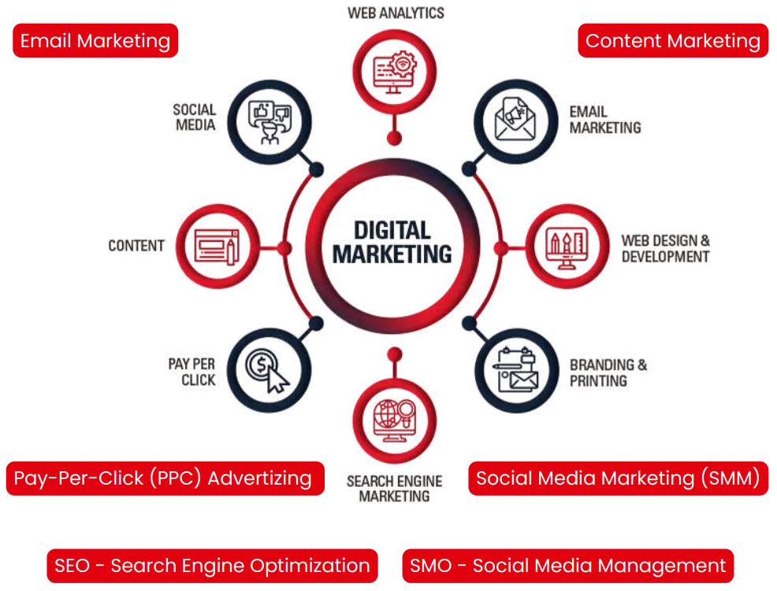
Digital Marketing Services
Indoscie Technologies uses Digital marketing in drafting a multifaceted strategy aimed to target, reach out to, and build relationships with customers online, across a broad range of channels. It encompasses all marketing efforts that use an electronic device or the internet.
www.indoscie.com

Slide 14
Our Projects
B2B | E-Commerce | Events/Webinars | Others
Connecting Shops (https://connectingshops.com/ ) | Printinkart (https://printinkart.com/ ) | 99learnings (https://99learnings.com/services-combo.php) | Builder Planner (https://www.buildingplanner.in/)
 | Multicraft (https://multycraft.com/) | 99seminars (https://99seminars.com/) | AISCF (https://aiscf.in/)
 | Craftpetals (https://www.craftpetals.com/) |  | The Problem Solve (http://theproblemsolves.com/)
 | Digimpact (https://digimpact.in/)
 | Computerheal (https://computerheal.in/)
www.indoscie.com

Slide 15
Meet our teams
Er. Raj Kumar Vishwakarma (MD & CEO – B.Tech)
Manish Vishwakarma (Director - BCA)
www.indoscie.com

Slide 16
Get in touch
Elevate your digital presence with our integrated IT and digital marketing solutions. Contact us today to embark on a journey of innovation and online success.
Contact Us:
WhatsApp Only: +91-9765280961 / +91-9315232308
www.indoscie.com
enquiry@indoscie.com / support@indoscie.com / hr@indoscie.com
Address: Ground Floor, Office No.7, Akelwa Bridge, Varanasi, U.P., India
Landmark- Ganjari International Cricket Stadium
Follow us on:
LinkedIn: https://www.linkedin.com/company/indoscie-technologies/
Instagram: https://www.instagram.com/indoscie_technologies/
www.indoscie.com

Slide 17
Thank You!
www.indoscie.com

